Slide 1
Amsterdam Life Sciences Café

Slide 2
Jeroen Maas Amsterdam Economic Board
Marc ter Haar EY

Slide 3
What are we working on
Infrastructure
Data Analytics& Services
1) Infrastructure:
- (Hardware)
- Collaboration
- Governance
- FAIR data
2) LSH Ecosystem
- Capabilities
- Players
- Integration
3) Data Analytics & Services
- Connected value chain
- Across health continuum
- Across disciplines and sectors

Slide 4
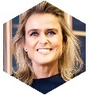
Board members
Chair
Femke Halsema
Burgermeester van Amsterdam en voorzitter van de Amsterdam Economic Board en Amsterdam Network Council
Knowledge institutions
Companies
Governments
Jacqueline Cramer
Regisseur Circulaire Economie
Hans Bakker
Voorzitter VNO-NCW
Metropoolregio Amsterdam
Barbara Baarsma
Directievoorzitter Rabobank
Amsterdam
Jeroen Tas
Chief Innovation & Strategy Officer Philips
Jaap Bond
Gedeputeerde Provincie Noord Holland
Geert ten Dam
Voorzitter College van Bestuur Universiteit van Amsterdam
André van den Berg
Chief Commercial Officer Schiphol Group
Marcel van Loo
Managing Partner EMEIA Financial Services
EY Netherlands
Ingrid Thijssen
CEO Alliander
Wimar Jaeger
Wethouder Gemeente Hilversum
Huib de Jong
Voorzitter College van Bestuur Hogeschool van Amsterdam
Hans Fischer
CEO Tata Steel Europe
Henk Markerink
CEO Amsterdam ArenA
Syro Ronda
Senior Business Analyst Siemens Young on Board
Udo Kock
Wethouder Gemeente Amsterdam
Mirjam van Praag
Voorzitter College van Bestuur Vrije Universiteit
Chris Heutink
Lid Raad van Bestuur Randstad Groep Nederland
Joris Schoonis
AVP Marketing Cloud Europe & Israel Salesforce
Roulerend lid
Young on Board
Franc Weerwind
Burgemeester Gemeente Almere
Hans Snijders
Voorzitter College van Bestuur Nova College
Erik Henstra
Managing Director LeasePlan NL
Yuri Sebregts
Vice President Innovation and R&D and CTO Shell

Slide 5
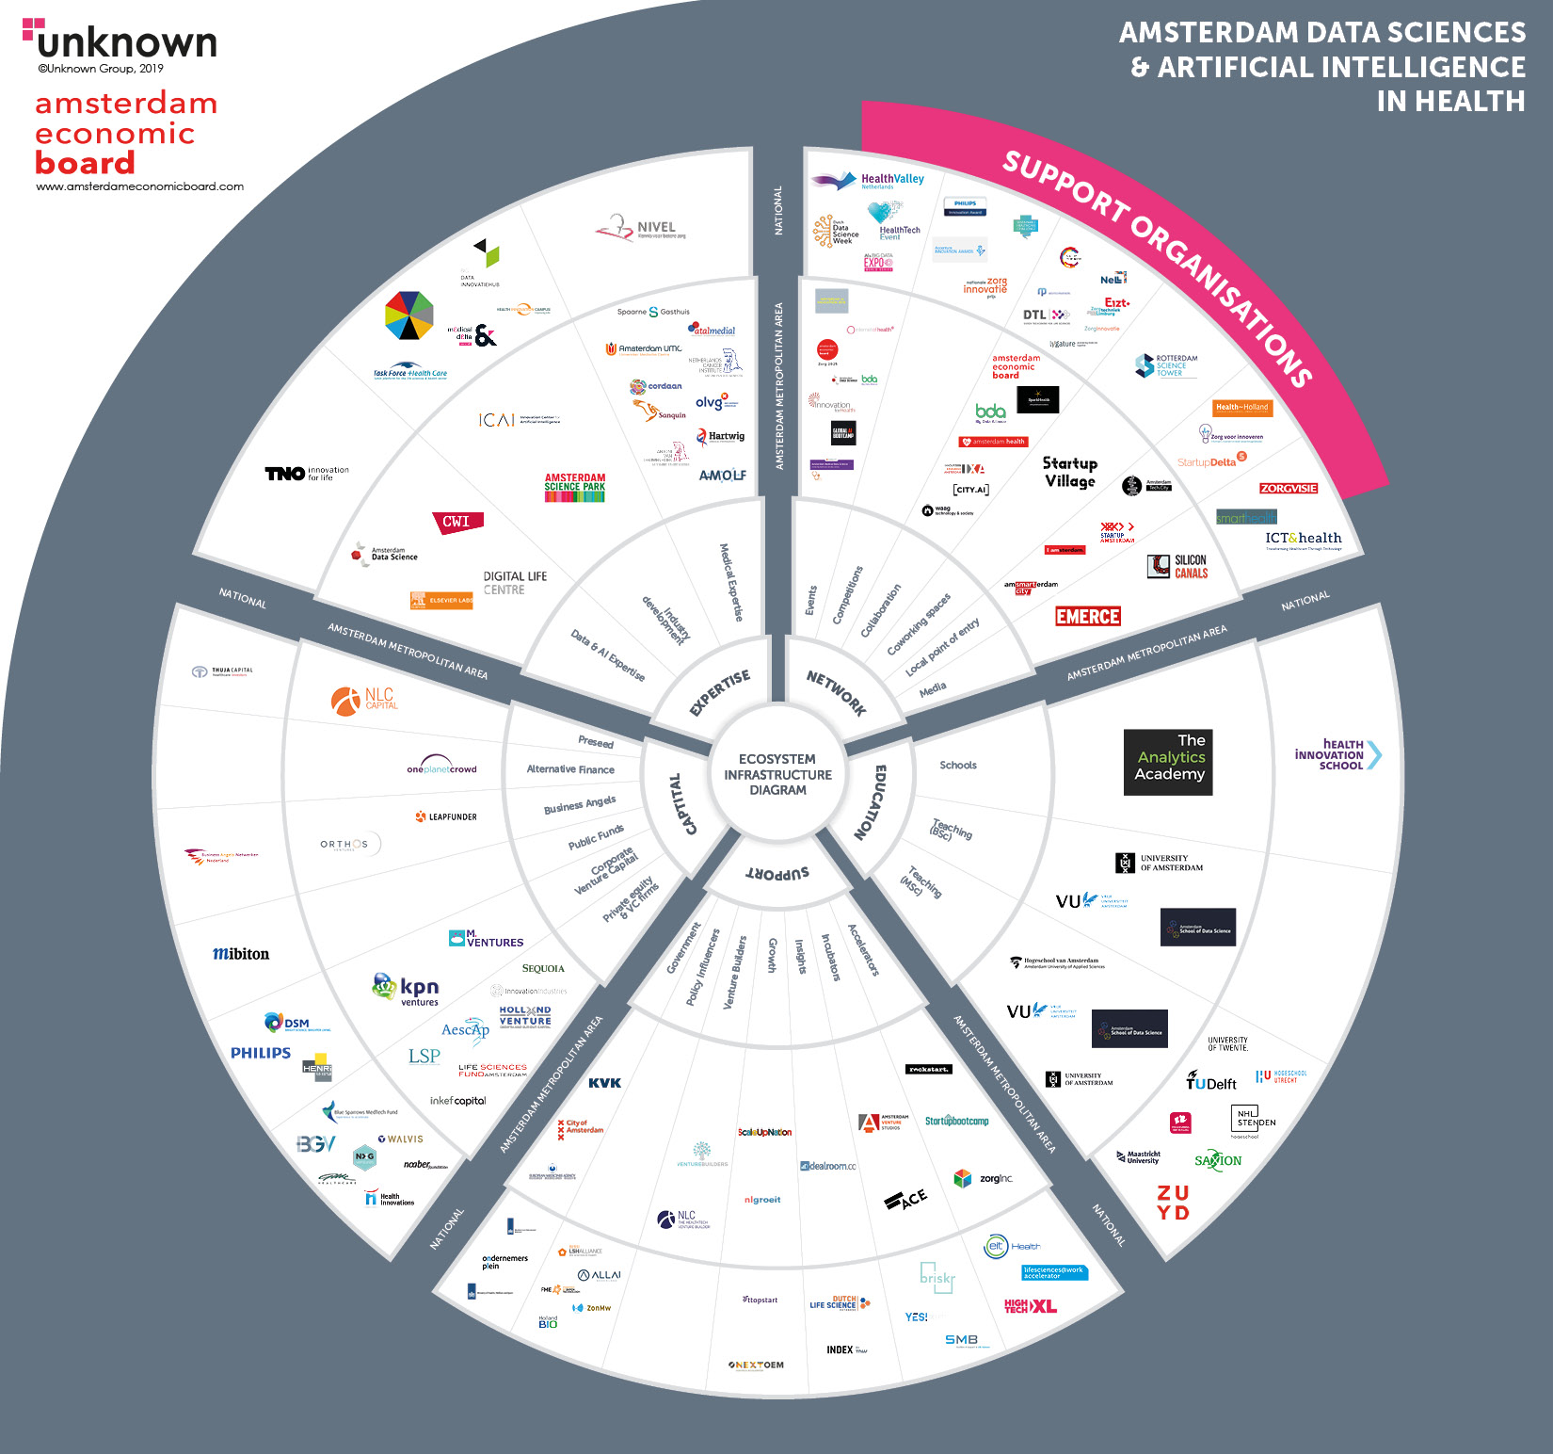
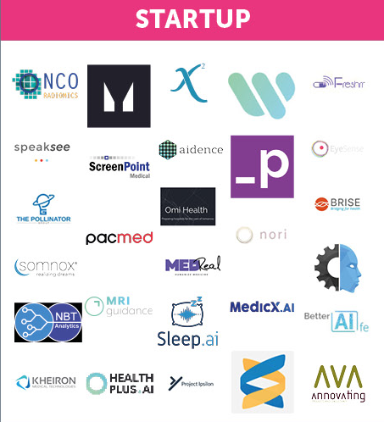
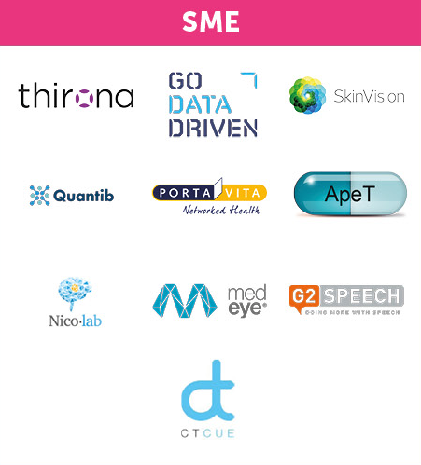
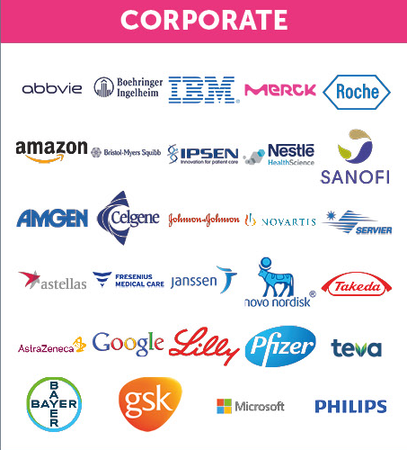

Slide 6
The European Biotechnology Start-up Landscape
Rogier Rooswinkel

Slide 7
Overview Forbion.
Based in the Netherlands
and Germany
12 years
history
of success
Over €1B under management in
4 Investment Funds
3 Co-Investment-Funds
3 Seed funds (BGV)
70 investments
in EU and US
9 product launches
Millions of people benefit from improvements made
Fully life science focused
Team with complementing background: PhD’s, MD’s and investment bankers
Staying close to science and bioentrepreneurs

Slide 8
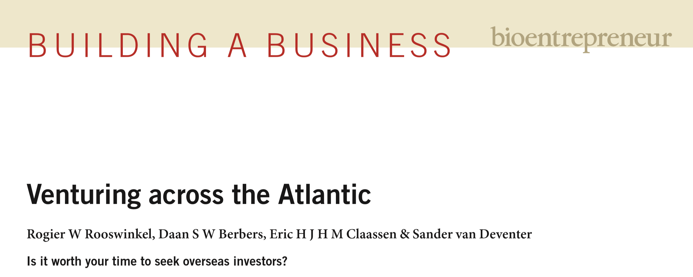
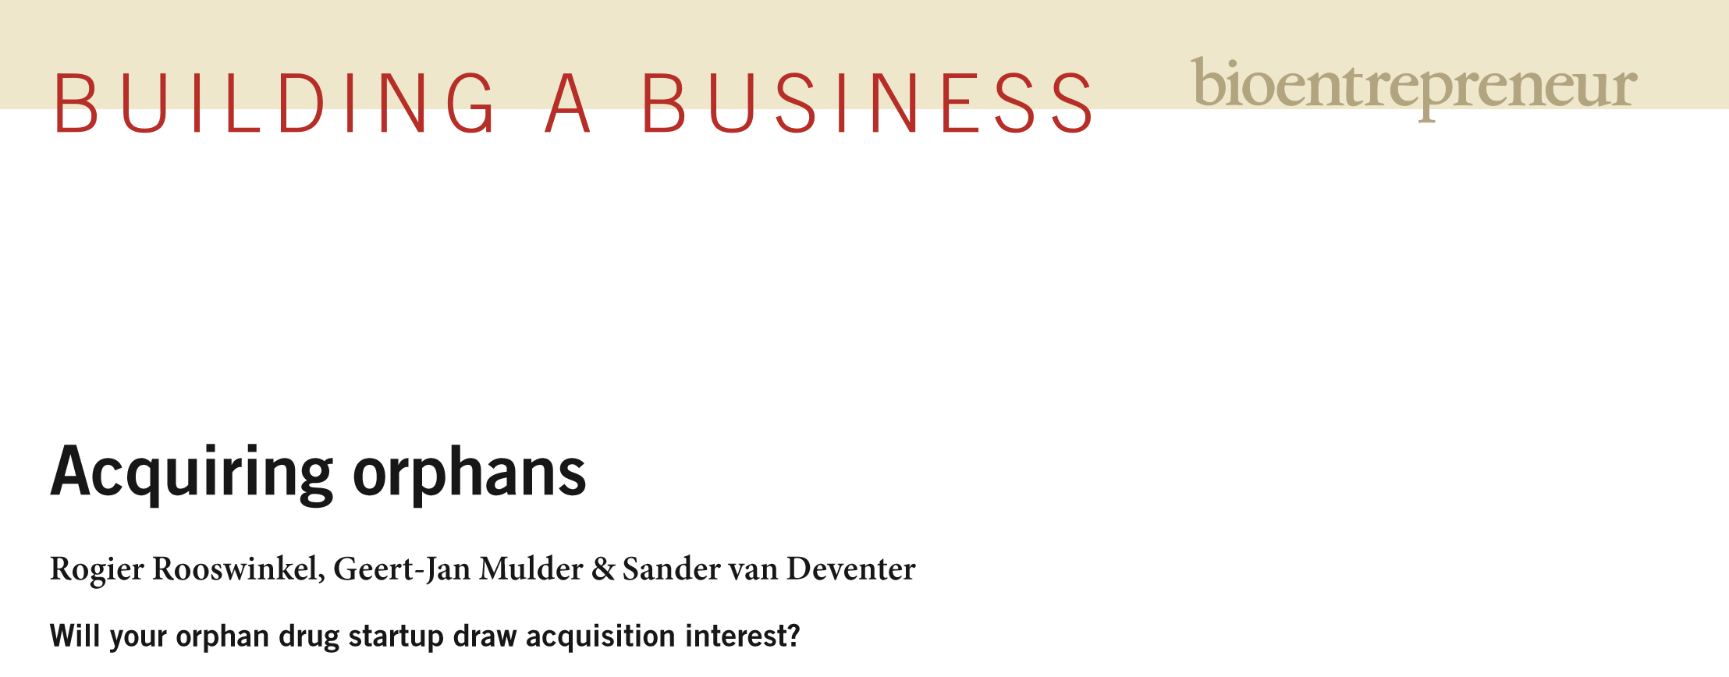
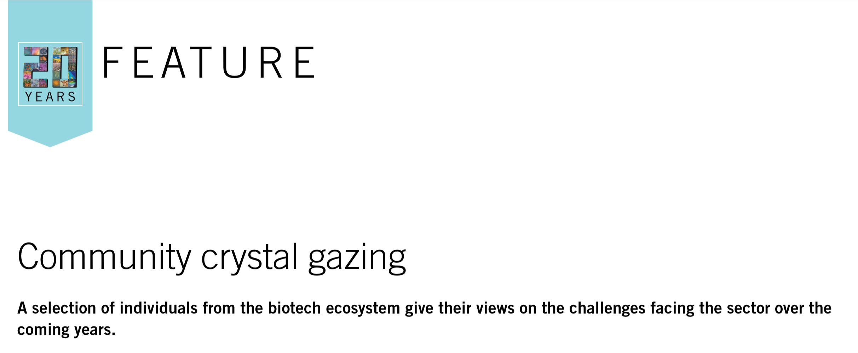
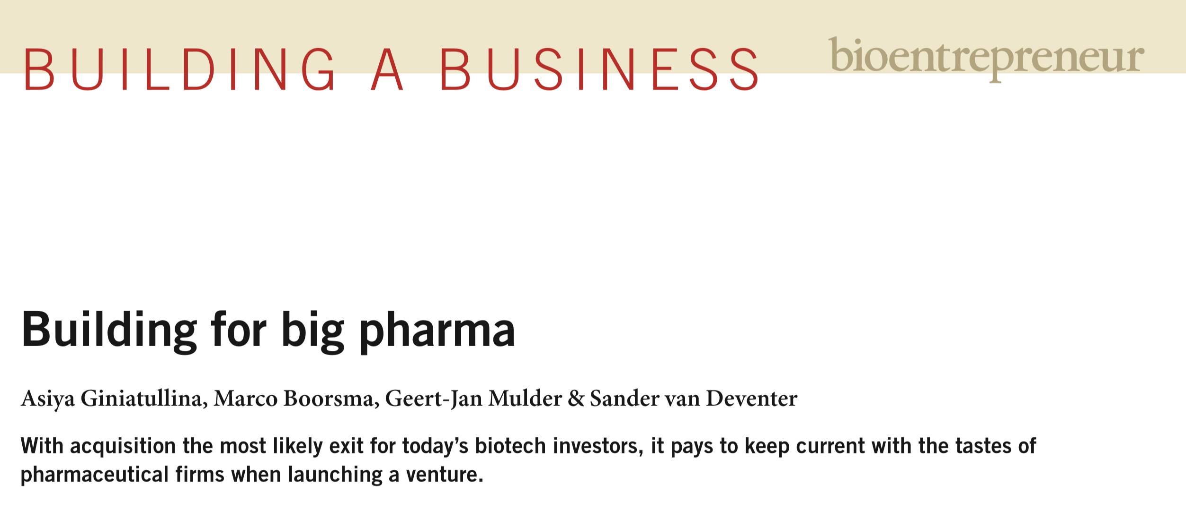
Forbion “bioentrepreneur” business research publication series in Nature Biotechnology

Slide 9
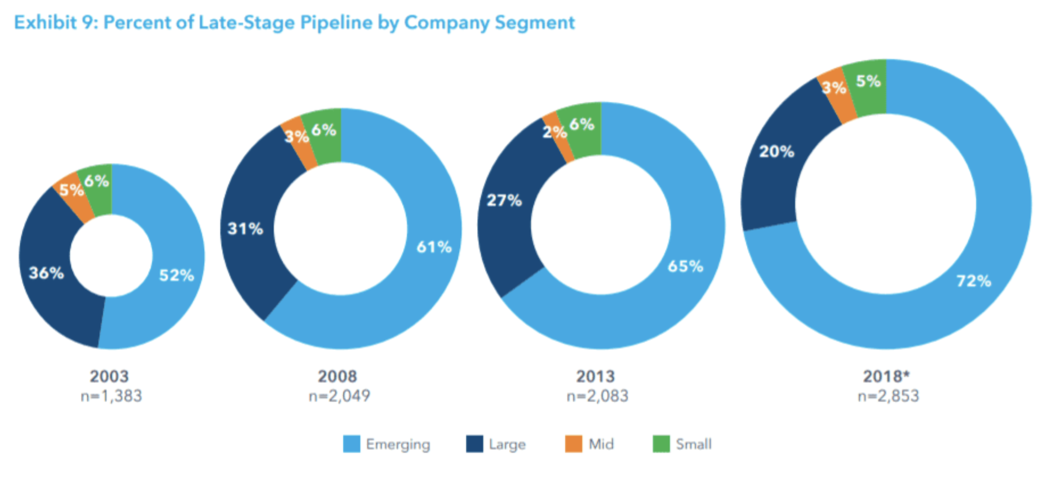
Emerging biomedical companies drive drug development and innovation
Emerging companies now control 72% of 2,853 late-stage drugs
Big Pharma’s share of the late-stage pipeline has plunged 20%
IQVIA Pipeline Intelligence April 2018, IQVIA Institute May 2019

Slide 10
So, what about the NL Biotech landscape?

Slide 11
Bonnie van Wilgenburg, Kim van Wilgenburg, Kathryn Paisner, Sander van Deventer and Rogier Rooswinkel. Nature Biotechnology April 2019
Period 2013-2017 (5 years)
Analysis restricted to countries with more than 1 million inhabitants and at least two start-ups within the study period
Considered Science, Patenting, VC presence and proxies to human capital

Slide 12
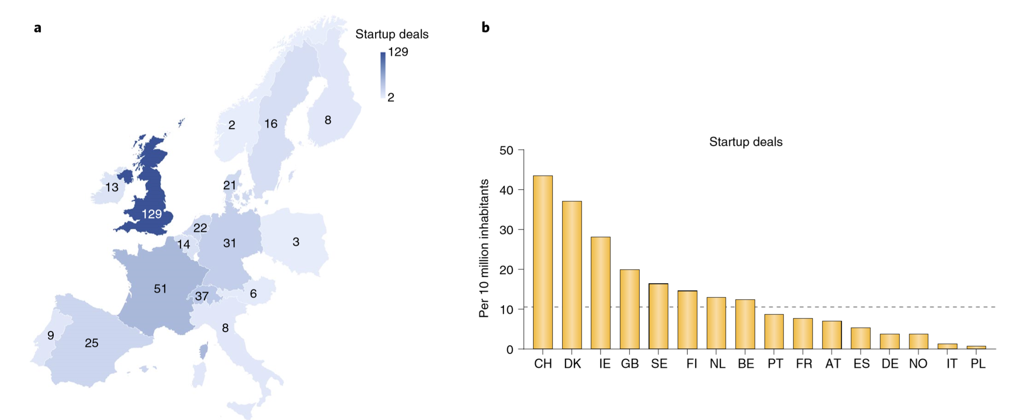
The European Biotechnology Start-up Landscape
Start-up defined as first time a company raises seed- or start-up capital (source: GlobalData Pharmaceutical database)

Slide 13
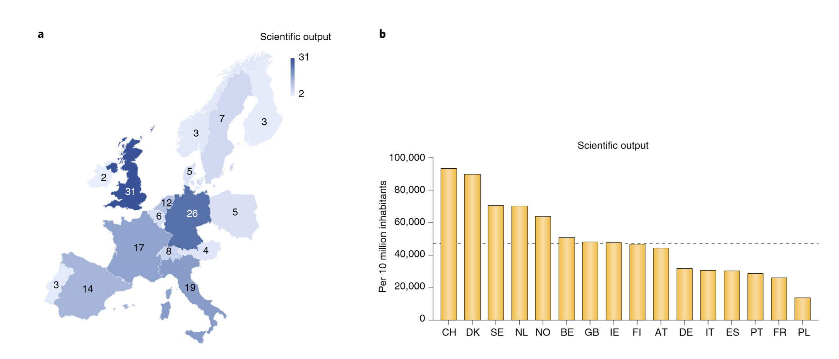
European Biomedical Scientific Output
As a proxy for research productivity, we used the total number of citable and non-citable documents published in the field of medicine in 2013–2017 obtained from Scimago

Slide 14
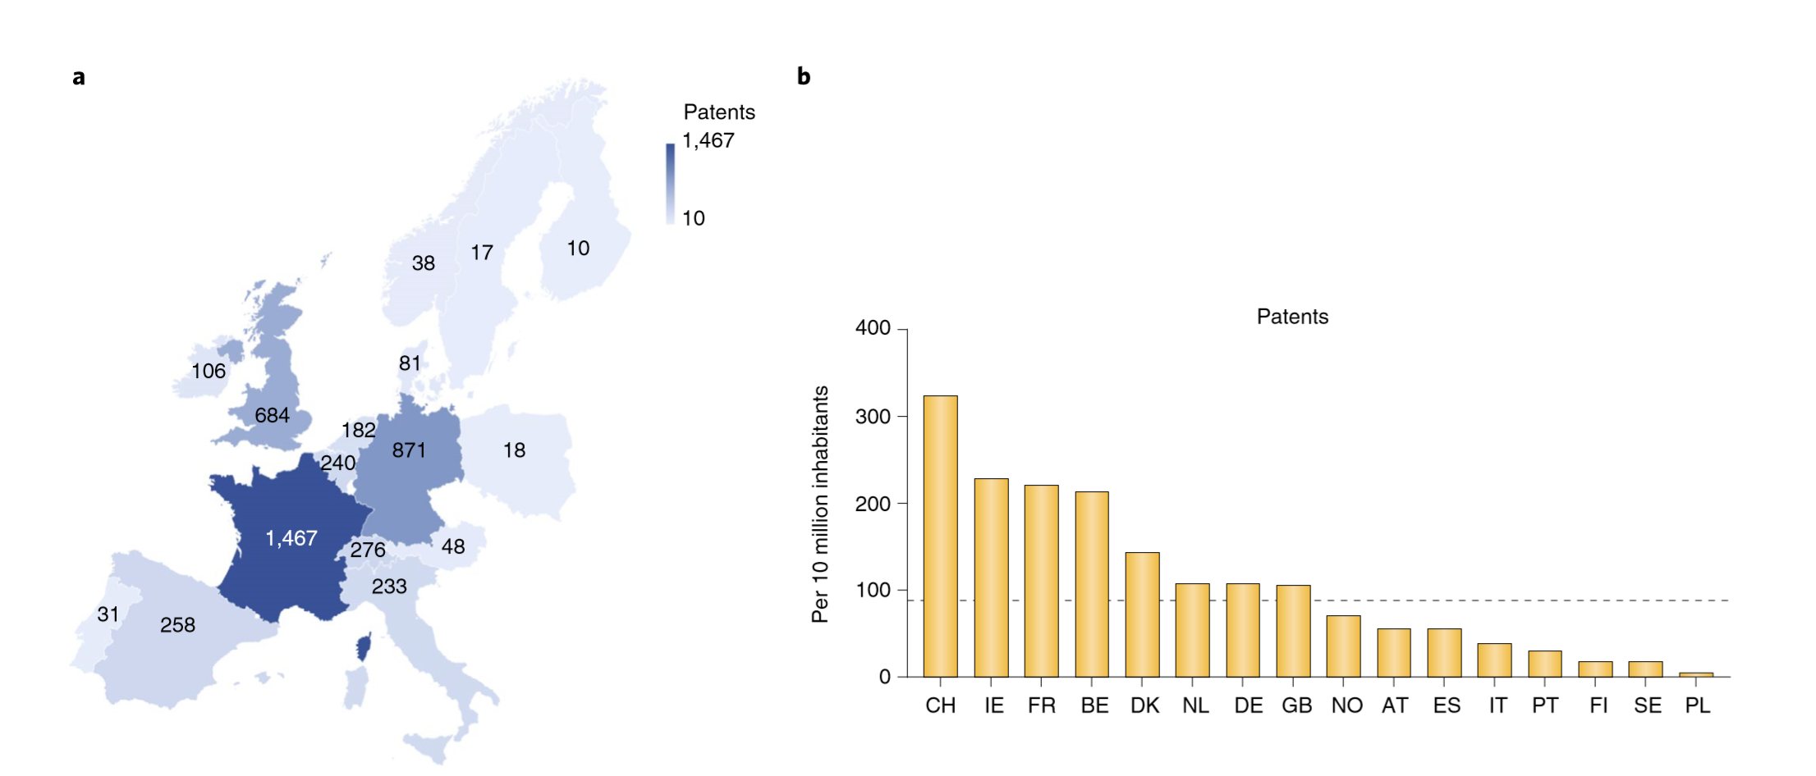
European Biomedical Patenting
Counted biotechnology patents filed per country/capita with Nat Biotech Patent lawyer

Slide 15
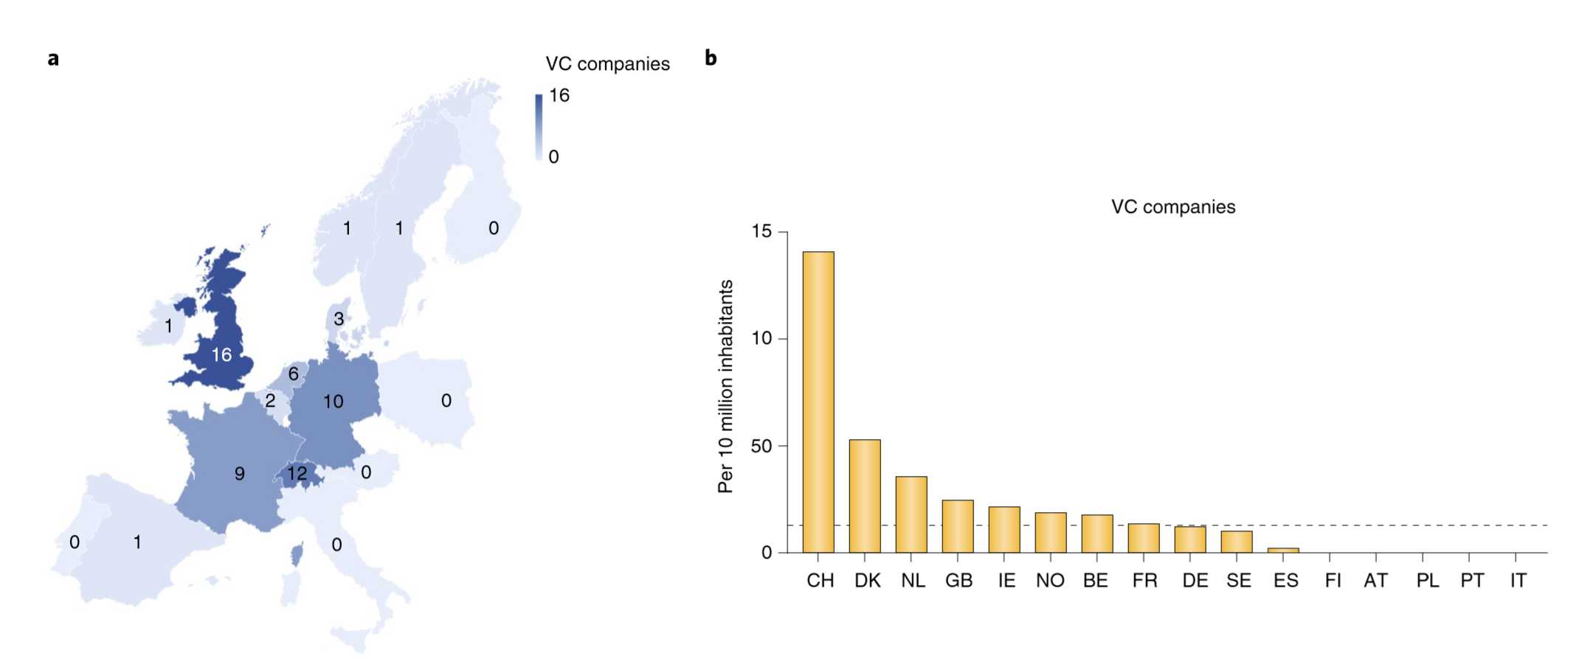
European Life Science VC’s
Selected VC firms that had done at least 5 new investments over the last 5 yrs (investments coming from Biocentury db)

Slide 16
Life Science Human Capital
Number of Principal investigators that started at least one clinical trial per year in the past 5 years (globaldata) “KOL’s ”
We mapped nations on the basis of the 2017 Global Entrepreneurship Index, GGDI

Slide 17
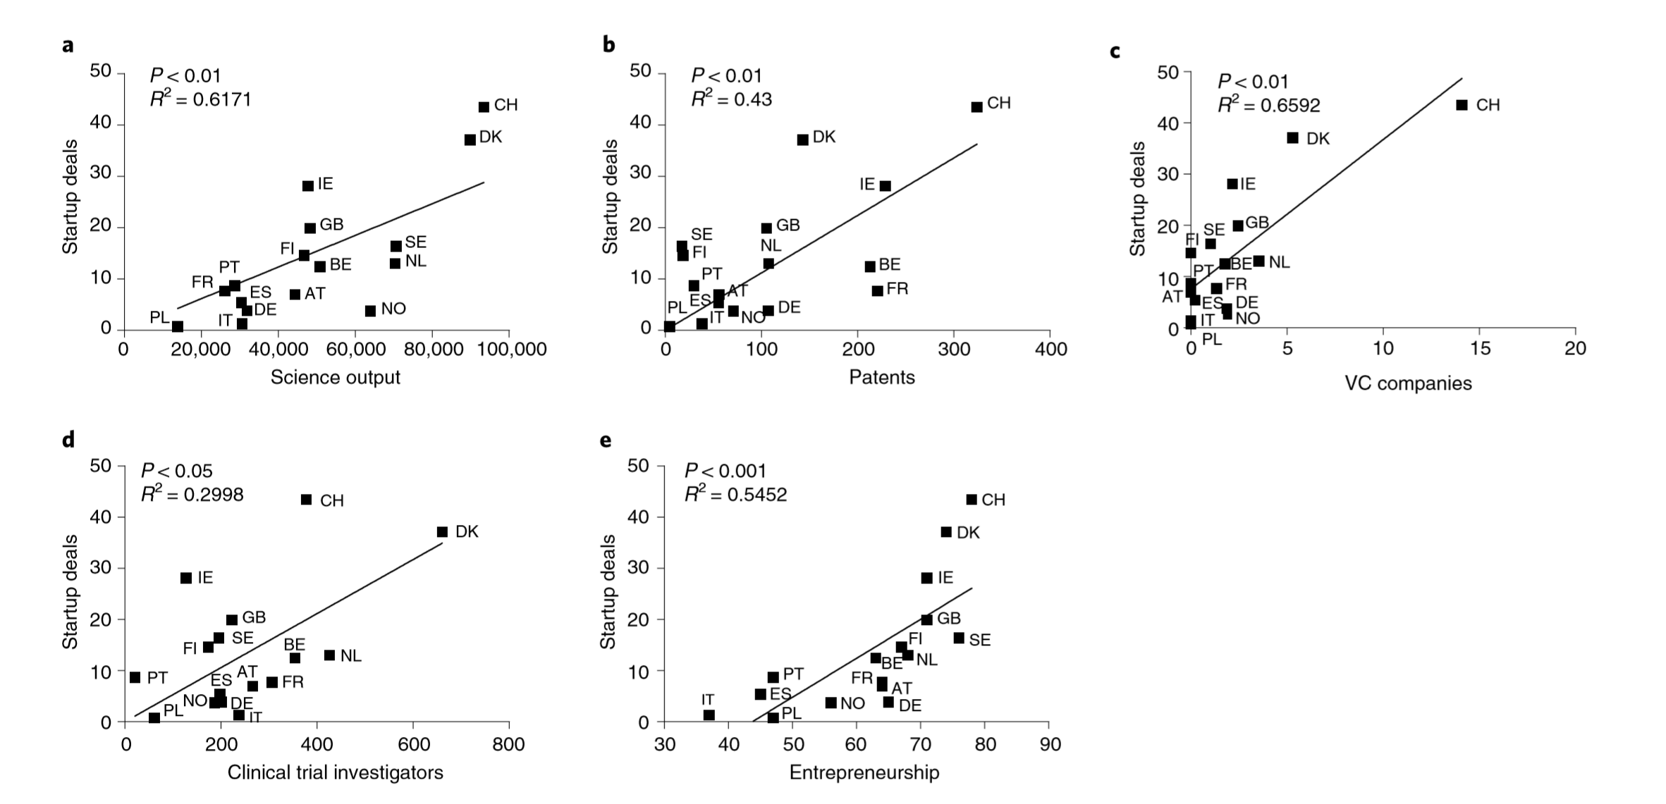
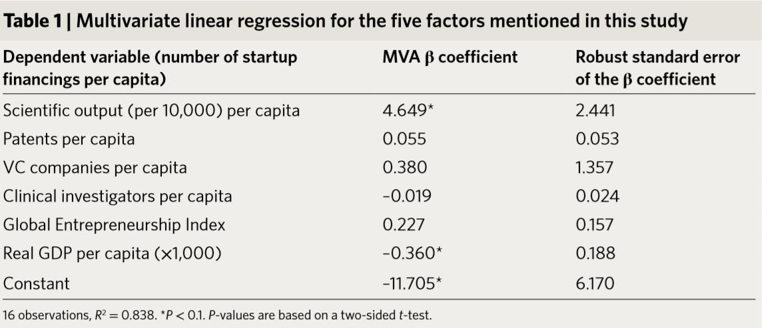
What drives Biotech Start-up initiation in Europe?
All factors combined explain 83% of the startup variation

Slide 18
What can we do/should we not do in the Netherlands?
Invest in Science and education
Protect and respect intellectual property; professionalize tech transfer offices
Recognize the importance of Key Opinion Leaders/principle investigators (“large pharma prostitutes”)
Recognize the dramatic improvements in therapeutic efficacy and pay for innovative drugs
Facilitate, rather than block, innovative clinical development

Slide 19
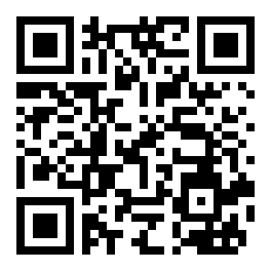
Contact us & stay in touch
Central e-mail address for team
LSH Amsterdam: lsh@amsterdam.nl
Join other Amsterdam health
innovators on our Linkedin group
Amsterdam Health
Ideas, suggestions & info: j.maas@amecboard.com

