Slide 1
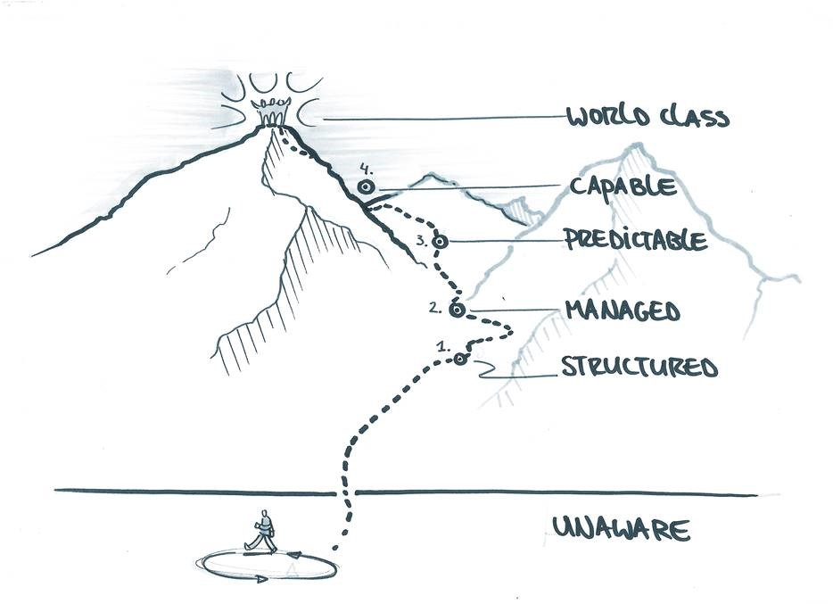
‘Gap’-analysis International Advisory Board
First results and conclusions
May 2017

Slide 2
Contents
The reasons for doing a ‘gap’-analysis and its value for the work of the IAB
Conducting the ‘gap’-analysis
The need for a pragmatic approach
Using information from benchmarks and other reports
Using expert judgements obtained using questionnaires
Where do we stand on the challenges?
The relative position of the MRA compared to other city regions
The gap between the actual position of the MRA on the challenges and the formulated ambition
City regions that seem to be inspiring examples for the MRA on specific challenges
Some first conclusions
How to proceed
Appendix 1 - Measuring the ‘gap’: some methodological issues

Slide 3
The reasons for doing a ‘gap’-analysis and its value for the work of the IAB
The wish of the Board organisation is to come to a more evidence based approach
The desire of the IAB to obtain more insight into the relative position of the MRA on the 5 challenges and on the gap between the actual position of the MRA on the challenges and the formulated ambition
The desire of the IAB to obtain more insight into what city regions are the most inspiring examples and why they are inspiring

Slide 4
Conducting the ‘gap’-analysis
What did we do?
We chose a pragmatic approach
We collected information from benchmarks and other reports
We asked for input from experts (members of the IAB, business connectors and others) using questionnaires
We sketched where we stand:
What are the formulated ambitions?
Where do we stand? What is our international position?
What are inspiring examples and proven successes (best practices) from other city regions? What emergent practices are worth exploring in the context of the five urban challenges?

Slide 5
Some first findings:
where do we stand on
the challenges?

Slide 6
Digital connectivity – our ambitions
By 2025 the AMA will be:
Europe’s premier location for data-driven innovation
An international frontrunner in terms of the available digital infrastructure and the ability to build innovative data-driven applications using this infrastructure, as well as in terms of public trust in a digital society
More specifically:
By 2025 Amsterdam should be Europe’s premier digital port and the undisputed central hub of the internet
We will celebrate the first anniversary of digital citizens’ rights in 2025
In 2025, the AMA will have made substantial progress in the areas of health, mobility and circular economy thanks to the sharing of trusted data

Slide 7
Digital connectivity - where we stand
PWC’s Cities of Opportunity
“In terms of business Amsterdam is leading internationally. In terms of government policy Amsterdam is average or even lagging behind. The government isn’t fully aware of the potential that we have” (Eric Boonstra, Evoswitch)
“Other regions seem to be more aware of the vital importance of a symmetric future proof communication infrastructure” (Frans-Anton Vermast, Smart city expert)
“The Netherlands is one of the biggest data hubs in the world and the focus point lies in the AMA. This makes AMA a magnet for FDI in data hubs. To accommodate further growth challenges need to be addressed on short notice” (Stijn Grove, Dutch Datacentre Association)
#13 (out of 30) in terms of Digital security
#10 (out of 30) in terms of Broadband quality
Nesta CITIE report
#1 (Tier 1 performer) as a city facilitating physical and digital connectivity
European Digital City Index 2016
#3 (out of 60) in terms of digital startups
#5 (out of 60) in terms of digital scale-ups
#13 (out of 60) in terms of digital infrastructure: as points for attention are mentioned the cost of broadband, fibre internet* what does this mean?

Slide 8
Digital connectivity - best practices
Top-ranked cities in PWC Cities of Opportunity Report
In terms of broadband quality In terms of digital security
#1 – Hong Kong #1 – Tokyo
# 2 – Singapore #2 - Singapore
# 3 – Seoul #3 – New York
Top-ranked cities in the European Digital City Index 2016
#1 – Bucharest
#2 – Vilnius
#3 – Riga
Digital connectivity initiatives of interest
In Barcelona and Estonia … interesting projects have been launched focusing on trust in digital life
Dublin, Stockholm and Helsinki … are inspiring cities in terms of using public data to address societal challenges

Slide 9
Circular Economy - our ambitions
By 2025 the AMA will:
be a global frontrunner in finding smart solutions to limited resource availability
be recognized as pioneers in the redesign and closing of energy, water, and material cycles. This will allow us to realise innovation and new business development throughout the region
More specifically, the AMA will have:
high value recycling of resource flows and more tailored initiatives for circular building and demolition; high-value recycling of vegetable, fruit and garden waste; a fibre unravelling installation for non-rewearable textiles; a recycling plant for personal hygiene waste (diapers, toilet papers)
systems in place that make it easier to repair products and separate waste for circular reuse
made huge steps to accelerate the energy transition including the re-use of residual heat and industrial CO2 emissions, as well as improving energy efficiency in the built environment

Slide 10
Circular Economy - where we stand
Siemens: European Green City Index
PWC: Cities of Opportunity
#1 in waste and land use
#29 in natural disaster exposure
#1 in water usage
#5 in natural disaster preparedness
#5 in energy consumption
#6 in energy efficient buildings
Nesta CITIE report
#11 in air quality
Tier 2 city as customer for innovation
#12 in CO2 emissions
Global Power Cities Index
“The MRA is a leader in developing circular ambitions through both the great willingness in politics, business and social institutions and knowledge institutes. There is a lot of communication outside and there are many networks. What the MRA can do even better is actually making money for circular innovation and large-scale investment.”
#6 in CO2 emissions
#15 in percentage of waste recycled
#31 in percentage of renewable energy used*
-Micha Hes, Port of Amsterdam

Slide 11
Circular Economy - best practices
Top-ranked cities in Siemens European Green City Index
#1 - Copenhagen
#2 - Stockholm
#3 - Oslo
Circular economy initiatives of interest
In London, the city’s Waste and Recycling Board has established a “dating agency” to provide interested companies with different kinds of waste for fuel or recycling
In Ljubljana, the municipality created a “lottery” to encourage recycling. On a regular basis, a household or office recycling bin is randomly selected, and if it contains the right type of waste, a reward is provided
In Vienna, the city has created the Vienna Repair Network, a group of 50 repair shops what provide discounts and financial incentives for customers who use their services.

Slide 12
Health - our ambitions
By 2025:
inhabitants of the AMA will have added two healthy years to their life-span
we will be recognized as a global leader in healthy living and active aging, with inhabitants firmly in control of their own health
our healthcare system will have undergone a series of innovations
More specifically, the AMA will have:
raised awareness about healthy food and ensured healthy food options are available to all
used data and technology to create an environment that makes exercise more appealing
created healthy working and living environments and personalized health solutions tailored to the needs of individuals

Slide 13
Health - where we stand
PWC: Cities of Opportunity
“The MRA is definitely not a headliner [in this area]. The organizations and institutions are there, there is still a lack of cooperation…Traditional competition must be broken, both within business and between educational institutions and universities.”
–Sietse Dugour, CCO of Cinnovate
#15 in health systems performance
#18 in security and disease risk
#31 in percentage of renewable energy used*
Global Power City Index
#16 in number of medical doctors per population
“E-health initiatives are fragmented--there are low budgets and there is no academic coordination. As a result, hardly any validation and accreditation take place and applications are not used…In the field of serious games, Amsterdam has a huge advantage, but due to lack of coordination, initiatives remain small and results are far behind.”
-Hans Luijckx, IJsfontein
EIU Safe Cities Index
#13 in health security

Slide 14
Health - best practices
Top-ranked cities in health, safety, and security in PWC Cities of Opportunity Report
#1 - Tokyo
#2 - Toronto
#3 - Sydney
Health initiatives of interest
In Scotland, the “Age Scotland” campaign has advocated for a national strategy to tackle social isolation among older citizens and coordinate responses across social, healthcare, and transportation services.
In Copenhagen, the city’s data exchange has enabled the implementation of a wide range of health initiatives
Boston has established an integrated health system where citizens are able to monitor their own health and connect digitally to healthcare providers from their own homes

Slide 15
Mobility - our ambitions
By 2025:
city transport in the AMA will be emission free
we will be an international pioneer in smart and clean goods, services, and passenger transport
More specifically, the AMA will have:
advanced urban distribution with smart, clean, and demand-oriented transport of goods and passengers to their final destination in the city
mobility as a Service—a new take on transport that provides seamless connections throughout the entirety of a journey rather than separate modes of transport
positioned itself as a leading city region in terms of intelligent transport systems (ITS)
strengthened its position as a leading cycling city region and brought biking to the ‘next level’

Slide 16
Mobility - where we stand
PWC: Cities of Opportunity
European Digital Cities Index
#24 in affordability of public transit
#13 in train connectivity
#11 in traffic congestion
#5 in airport connectivity
#31 in percentage of renewable energy used*
#54 in average commute time and distance
Global Power Cities Index
ADL: The future of urban mobility
#3
#11 in density of suspended particulate matter
#9 in commuting convenience
Sootfree
#10 in best European practices for clean air in urban transport
There is awareness within the civil society about what the problem with city logistics is, but we are certainly not a leader in Europe.
–Walther Ploos van Amstel, Hogeschool van Amsterdam

Slide 17
Mobility - best practices
Top-ranked cities in transportation and infrastructure in PWC Cities of Opportunity Report
#1 – Singapore
#2 – Dubai
#3 - Stockholm
Top-ranked cities in transportation and infrastructure in ADL The future of urban mobility 2.0
#1 – Hong Kong
#2 - Stockholm
#3 - Amsterdam
Mobility initiatives of interest
Stockholm’s “Urban Mobility Strategy” takes a holistic, multi-modal view of reducing traffic congestion
Singapore has developed the “Smart Mobility 2030” plan, which aims to create more comprehensive and sustainable transportation throughout the region.
Helsinki is a pioneer city in terms of Mobility as a Serivce (MAAS), having instituted “Whim” in 2016

Slide 18
Jobs of the future - our ambitions
By 2025:
The AMA will have the most adaptive labour market in Europe
The AMA will be the most successful region when it comes to attracting, retaining, and deploying of Dutch and international talent
More specifically, the AMA will have:
an adaptive education system: prepared the education system (universities, universities of applied sciences and upper secondary vocational education) for the jobs of the future by helping them respond quickly and effectively to the changing market.
attracted and taken advantage of Dutch and international talent: attracting and retaining talent, both from the Netherlands and abroad, in response to market demands and maximizing their potential for the benefit of the region.
adapted to work in the future: promoted craftsmanship, paid increasing attention to ICT skills, created a more inclusive labor market, prepared employees for working in other types of organizations, and cultivated start-ups.

Slide 19
Jobs of the Future- where we stand
Global Power Cities Index
European Cities of the Future index
Out of top 10 in Human capital and Lifestyle
#37 out of 42 in human capital
PWC: Cities of Opportunity
#20 in ease of securing human resources
#29 out of 30 in World University Ranking
#39 in number of international schools
#11 in youthful cities index
#24 in number of international students
Nesta CITIE report
“Our position is average. Point of focus is the gap between education and the labour market and the widening skill-gap. Too little attention for life long learning” (Jilko Andringa – Manpower Group)
Tier 3 city as investor (building tech talent, support access to capital)

Slide 20
Jobs of the Future - best practices
Top-ranked cities in Ease of securing human resources in Global Power City Index 2016
Top-ranked cities in City as Investor in Nesta Citie report 2015–
Tier 1: Berlin, Boston, Chicago, Helsinki, London, New York City, Paris, San Francisco, Seattle.
Tier 2: Barcelona, Copenhagen, Hong Kong, Los Angeles, Melbourne, Moscow, Seoul, Singapore, Sydney, Tallinn, Tel Aviv, Toronto, Vancouver, Vienna.
#1 – New York
#2 - London
#3 - Singapore
Jobs of the Future initiatives of interest
In Paris … Ecole 42 is a response to a bogged down education system. The school does not have any professors, does not issue any diploma or degree, and is open 24/7. The training is inspired by new modern ways to teach which include peer-to-peer pedagogy and project-based learning.
London … sponsors designated technology apprenticeship schemes for young people between the ages of 16 and 23 who have few qualifications and who have not progressed to higher education. Evidence points to a strong return on investment.
Notes:
Nesta citie report: City as investor: How does the city invest in the skills and businesses required for innovation? Amsterdam is in tier 3!
a. are actively investing in building their tech talent base; and b. are supporting access to capital.
More about London:
In the London region alone, organisations saw an aggregate net benefit in 2012/13 of £202 million, with the average net benefit per apprentice in London at £2,261.15 At the national level, research has shown that apprenticeships contributed £34 billion to the UK economy in 2014.16
Key question: what emergent practices do we need to experiment with in order to have an adaptive labor market? – in the context of uncertainty about technologies and jobs that we do not know yet nor that we can predict? How do other cities experiment with preparing for the jobs of the future?

Slide 21
Some first conclusions
Measuring the gap between ambition and the actual situation on each challenge is more difficult then measuring the MRA’s relative position
Within each challenge there appears to be areas where AMA’s relative performance is quite good and where it is quite poor
Benchmarks have a blind spot for emerging new structures, cultures and technologies (which characterize societal transitions)
Some inspiring cities and best practices emerged from our research

Slide 22
How to proceed
Strengthening the evidence base
Do we want to follow up on the benchmarking exercise? If so, how?
Do we want to get more opinions of experts? If so, do we need to use a different approach?
Do we want extra information from (some of) the experts? If so, what information?
Do we think it is useful to get experts’ opinion yearly?
Digging deeper … to find inspiring examples
Which (themes within the) challenges ask for our further attention?
Which emerging new development, technologies and themes (that do not show up in the benchmarks yet) ask for our further attention?
What cities and what examples should be looked at more closely?
How do we find out whether examples from other city regions could work also in the context of the MRA?

Slide 23
Appendix 1 Measuring the ‘gap’: some methodological issues (1)
Advantages/disadvantages of city benchmarks for gap analysis
++ Insight into the relative strengths and weaknesses of city regions (based on a set of indicators for which there exist broad international and historically comparable data) + Able to spot current high-performing cities for learning opportunities
- Most benchmarks do not specifically focus on the Board challenges or do not focus on the MRA-level (but on just Amsterdam or the Netherlands as a whole)
- Lack of insight in the path development of (un)successful regions -- Blind spot for emerging new structures, cultures and technologies (which characterize societal transitions)
Moreover:
Measuring the gap between the actual position of the MRA on the challenges and the formulated ambition is hardly possible since the road to the formulated ambitions is not a linear one, but a complex transition process (the Board challenges are not ‘a man to the moon’ ambitions but rather complex ‘solving the ghetto problem’ ambitions)

Slide 24
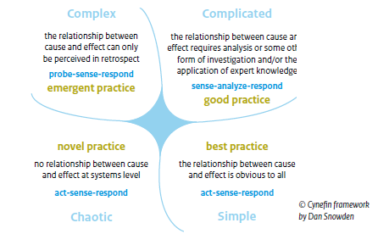
Appendix 1 Measuring the ‘gap’: some methodological issues (2)
The city-region is a complex adaptive system, the urban challenges are complex.
Notes:
City-regions are complex adaptive systems – featuring a large number of interacting components (agents, processes, etc.) whose aggregate activity is nonlinear (not derivable from the summations of the activity of individual components) and typically exhibits hierarchical self-organization under selective pressures. It
Possible example 1: difference between complicated problems and complex.
“In a complicated context, at least one right answer exists. In a complex context, however, right answers can’t be ferreted out. It's like the difference between, say, a Ferrari and the Brazilian rainforest. Ferraris are complicated machines, but an expert mechanic can take one apart and reassemble it without changing a thing. The car is static, and the whole is the sum of its parts. The rainforest, on the other hand, is in constant flux—a species becomes extinct, weather patterns change, an agricultural project reroutes a water source—and the whole is far more than the sum of its parts.^{[2]”}
Possible example 2:The moon and the ghetto (complicated versus complex)
In 1977, economist Richard Nelson posed a question that remains central to science and innovation policy: how is a rich country like America able to put a man on the moon, but is unable to solve the problems of its own ghettos? In September of this year, after the excitement that came with the launch of India’s latest space adventure had subsided, even those unfamiliar with Nelson’s work asked similar questions. The Economist wondered ‘how a country that cannot feed all of its people can find the money for a Mars mission’.
The first answer to Nelson’s question is that science and innovation are tied to social choices. There are good reasons why the Indian government should choose to invest in ambitious hi-tech programmes while also working towards public health just as there there are good reasons to challenge their balance of priorities. The discussion is a legitimately democratic one.
The second answer to Nelson’s question is that the problems of space and the problems of poverty are qualitatively different, demanding very different approaches. Space missions are about technological problems with technological solutions. It is normally clear whether or not they have succeeded. There is far more disagreement about causes and cures for ‘wicked’ problems of poverty or climate change. Science alone cannot give us the answer. https://www.theguardian.com/science/political-science/2014/dec/19/against-excellence
Uit “sturen in een verweven dynamiek” 2017 publicatie
Handelingstheorieen die lange tijd goed werken kunnen door leervermogen in het systeem hun waarde
verliezen. Zo bestaat een complex systeem uit dynamische interacties. Effecten stapelen
niet, maar interacteren. Ze staan niet los van elkaar, maar de gevolgen en effecten die ze
op elkaar hebben ontwikkelen zich wel voortdurend. Er ontstaan patronen in de interacties,
soms stabiliserend en behoudend, soms versnellend en veranderend. Interacties
zetten volgende interacties in beweging, waarin het systeem door al die interacties zelf
ook verandert. Effecten en gevolgen moeten daarom steeds als beweeglijk en in potentie
veranderlijk gezien worden. Eerste effecten kunnen weer verdampen, of hebben tijd nodig
om tot wasdom komen.
Dynamiek is ‘volgens’ het beeld van het complexe systeem wezenlijk anders dan vanuit
het gecompliceerde systeem bezien. Dat is niet hetzelfde als moeilijk versus simpel, of
veel relaties versus weinig relaties. Ook gecompliceerde systemen kunnen veel relaties
en factoren omvatten en uitzonderlijk moeilijk te begrijpen zijn. Complexe systemen
kunnen weinig componenten bevatten en toch complex zijn. Interactie is de essentie van
complexiteit: dat kan bestendigende interactie zijn, maar ook radicaal veranderende
interactie. Sturen en intervenieren heeft daarbij altijd enig effect, maar op welk niveau,
in welke mate, in welke periode en met welke reikwijdte is afhankelijk van hoe de
interventie in het systeem interacteert. Soms hebben kleine stappen grote gevolgen, soms
hebben hele grote interventies na een mogelijk aanvankelijke eerste grote schok amper
effect – bijvoorbeeld omdat het systeem ‘terugveert’ in de oorspronkelijke toestand of de
actie snelle tegenactie in allerlei delen van het systeem oproept.
Het besturen van complexe systemen
Grote transities laten zich niet oplossen naar analogie van het Manhattan- of
Apolloproject en de energietransitie is daarop geen uitzondering. In een complexiteitsperspectief
zijn silver bullet-oplossingen niet denkbaar en ook niet wenselijk, enerzijds omdat
de uitkomst van een interventie altijd een element van onzekerheid met zich meebrengt
en daardoor waarschijnlijk bijsturing behoeft, anderzijds ook omdat er in de context van
complexiteit altijd een brede benadering nodig is. In de woorden van complexiteitsonderzoeker
Robert Geyer: “Complexity emphasizes the range of strategies necessary to deal with
situations, rather than a hierarchy of strategies.”
In eerste instantie lijkt dat onbevredigend, een rem op het ambitie om snel door te
pakken, een teleurstelling voor wie direct wil handelen. Maar wie een complexiteitsperspectief
iets langer op zich in laat werken, zal zich realiseren dat een vat vol nieuwe
mogelijkheden zich opent; een geheel nieuwe kijk op sturing, verandering en transitie.
Binnen dit perspectief voor een energietransitie horen een zichtbare coordinatie door een
krachtig ministerie, een laissez-faire activistisch beleid met oog voor decentraal bestuur,
een ondernemende overheid, het direct inzetten van het extreem goedkope kapitaal dat
alleen de staat kan aantrekken en een originele communicatieaanpak. Modellen worden
ingezet om deelvraagstukken zoals pad-afhankelijkheden, technologieleercurves en de
besmetting van sociale normen beter te vatten – macro-economische modellen worden
voorlopig resoluut naar het wetenschappelijk onderzoek terugverwezen. Dit alles onder
bewust oncomfortabel hoog gestelde ambitieniveaus, die tot innovatie dwingen en niet
haalbaar zijn met alleen vertrouwde methodes.
(Uit ‘Sturen in een verweven dynamiek’ 2017)

